Slide 1
Creating Your First Spring MVC Application

Slide 2
Prerequisites
Java
Maven
IntelliJ
Tomcat

Slide 3

Getting Spring
No direct download
Maven
Source, Javadocs, Binaries Transitive dependencies Spring Boot

Slide 4
WAR vs. Contained

Slide 5
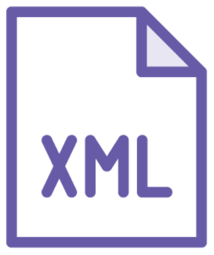



Configuration
Complicated
Blackbox

Slide 6
Spring MVC Configuration
pom.xml
Config
Java
View

Slide 7
Prerequisites
Getting Spring Configuration WAR vs. Contained
Summary
Spring MVC configuration

